Slide 1


CIS 8795 IT Infrastructure for Big Data
Predicting Dow Jones trends based on sentiment analysis of Daily News
Team Members:
Aditya Paliwal Souman Basha
Venkata Ramana Laurence McNally
Notes:
Give a brief overview of the presentation. Describe the major focus of the presentation and why it is important.
Introduce each of the major topics.
To provide a road map for the audience, you can repeat this Overview slide throughout the presentation, highlighting the particular topic you will discuss next.

Slide 2
Problem Statement
Predict whether the Dow Jones Industrial Average closes at a high or a low based upon analysis of the top 25 news headlines for that day.
What is the Dow Jones Industrial Average?
It is an index of 30 of the largest publicly owned companies based in the United States.
Dataset
Daily News for Stock Market Prediction from Kaggle [1]. Data from 2010 to 2016
1065 days out of 1989 days included in the dataset the Dow closed on a high
Notes:
Give a brief overview of the presentation. Describe the major focus of the presentation and why it is important.
Introduce each of the major topics.
To provide a road map for the audience, you can repeat this Overview slide throughout the presentation, highlighting the particular topic you will discuss next.

Slide 3
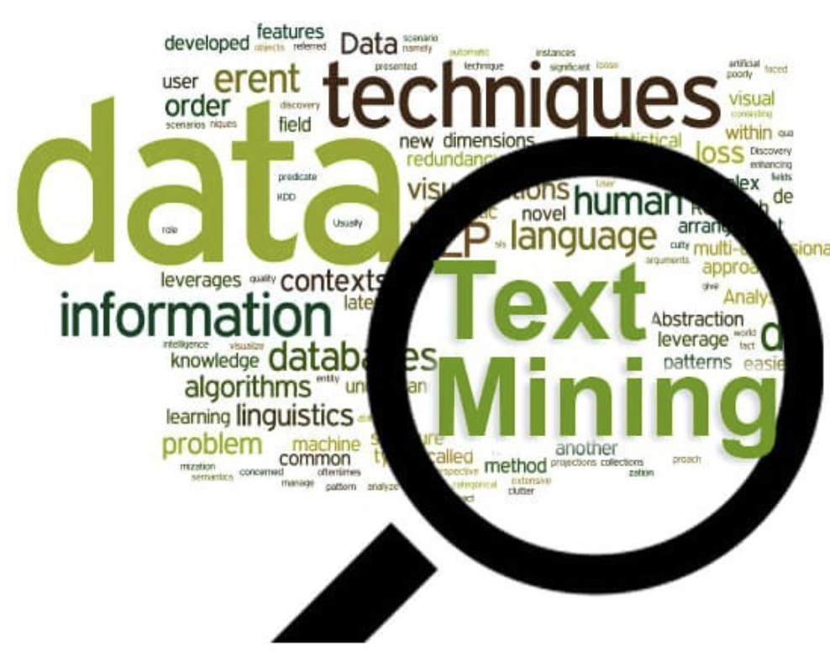


What we Plan to do?
+
DOW
Notes:
Give a brief overview of the presentation. Describe the major focus of the presentation and why it is important.
Introduce each of the major topics.
To provide a road map for the audience, you can repeat this Overview slide throughout the presentation, highlighting the particular topic you will discuss next.

Slide 4
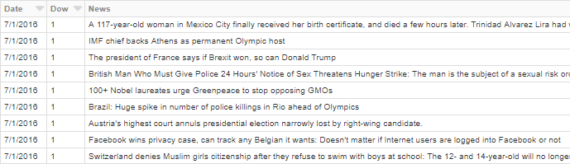
Data Sample
Notes:
Give a brief overview of the presentation. Describe the major focus of the presentation and why it is important.
Introduce each of the major topics.
To provide a road map for the audience, you can repeat this Overview slide throughout the presentation, highlighting the particular topic you will discuss next.

Slide 5
Data Preparation
Data read in using spark.read
Casted columns to desired data type:
News to a String
Dow to a Double
Date to M/dd/yyyy
Use a UDF to remove unwanted characters from all text of News
Drop null values
Splitting data in training and test sets
Notes:
Give a brief overview of the presentation. Describe the major focus of the presentation and why it is important.
Introduce each of the major topics.
To provide a road map for the audience, you can repeat this Overview slide throughout the presentation, highlighting the particular topic you will discuss next.

Slide 6
Model
Bucketizer – Dow high(1) or low(0)
Tokenizer – Parse input text
Removed stop words
converts text to vectors using – CountVectorizer, Ngram (ngram2, ngram3)
Inverse document frequency
Build a pipeline with 3 algorithms:
Logistic Regression
Random Forests
Naive Bayes
Executed the 3 models in 3 folds using Cross Validator
Compared the 3 models on train data using Parameter Grid
Executed the best model with the test data
Notes:
Give a brief overview of the presentation. Describe the major focus of the presentation and why it is important.
Introduce each of the major topics.
To provide a road map for the audience, you can repeat this Overview slide throughout the presentation, highlighting the particular topic you will discuss next.

Slide 7
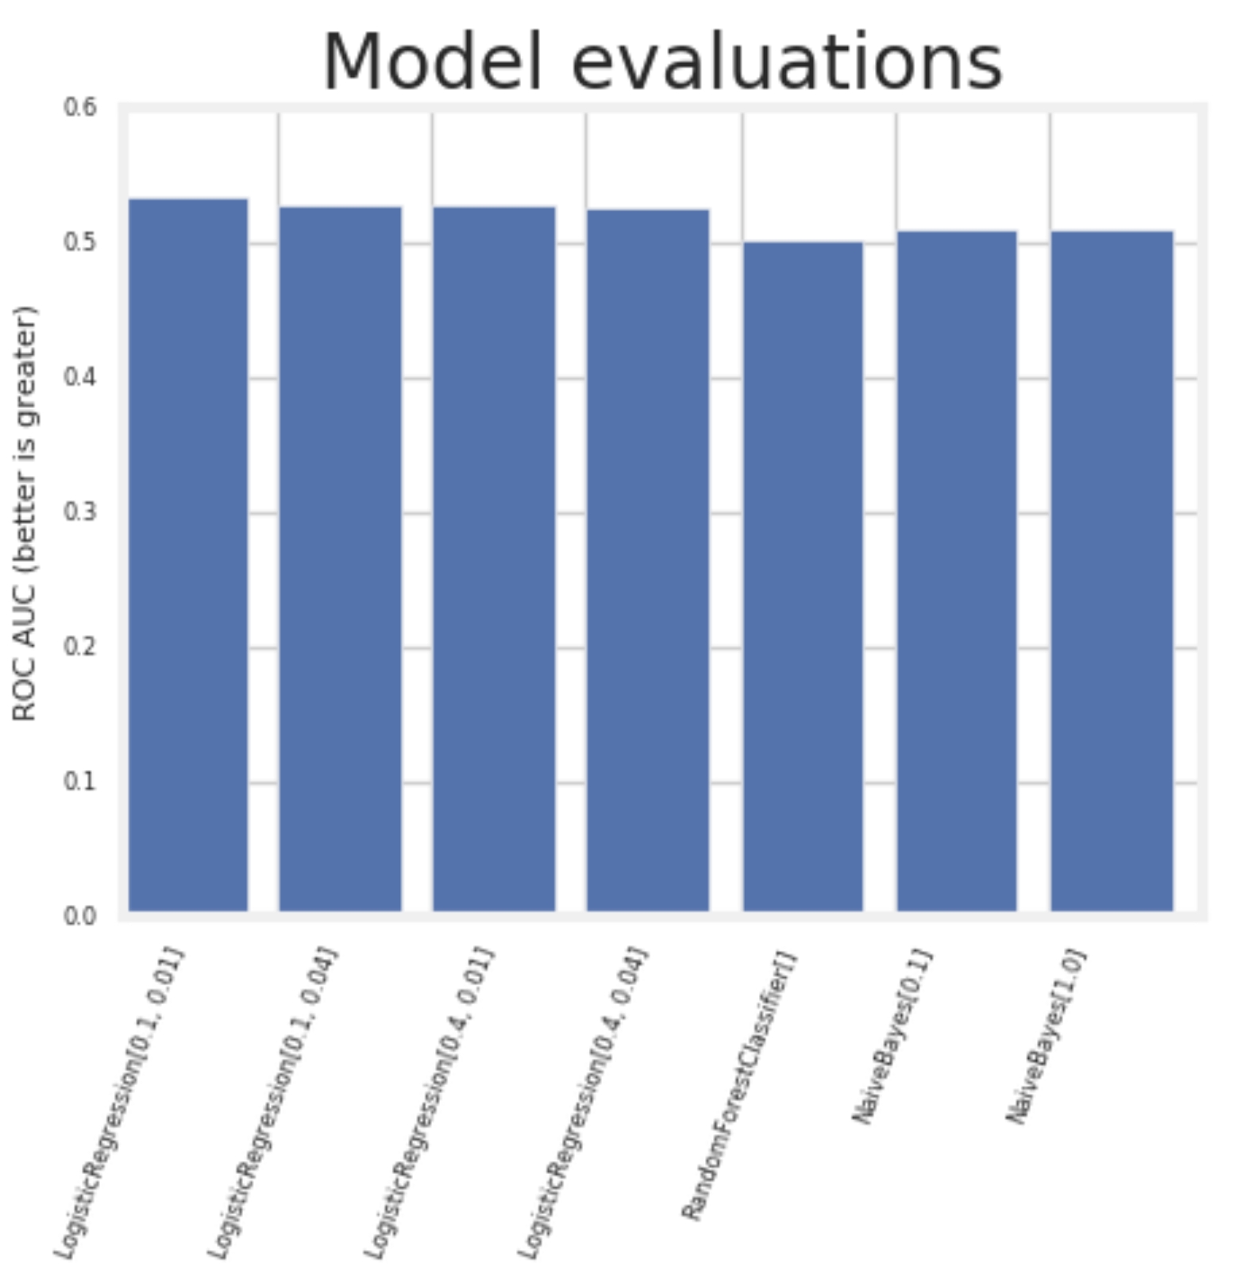
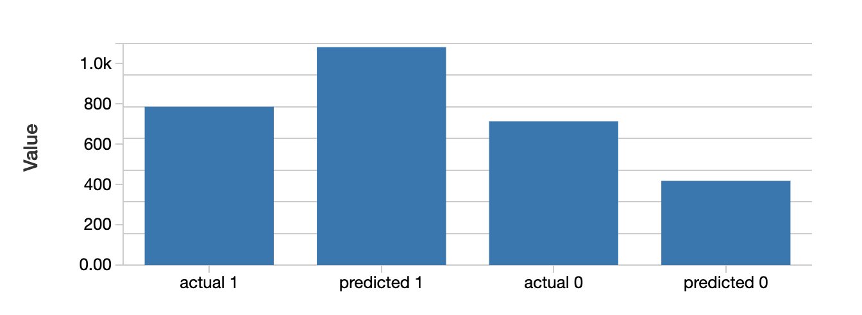
Results
Logistic Regression [0.1,0.01] was the best
Area under PR = 0.53
Area under ROC = 0.51
786 1082 714 418
Notes:
Give a brief overview of the presentation. Describe the major focus of the presentation and why it is important.
Introduce each of the major topics.
To provide a road map for the audience, you can repeat this Overview slide throughout the presentation, highlighting the particular topic you will discuss next.

Slide 8
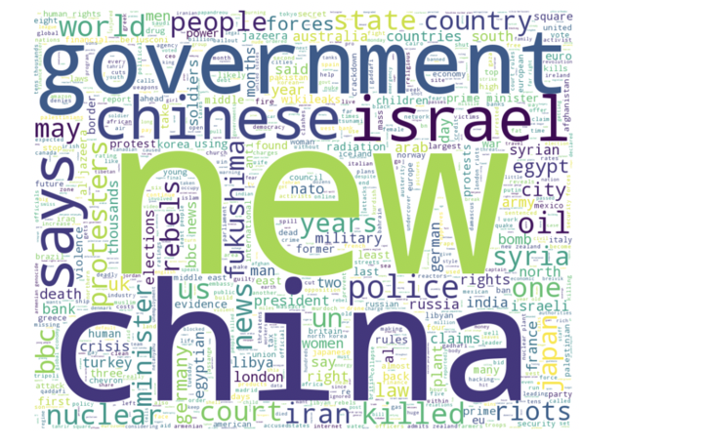
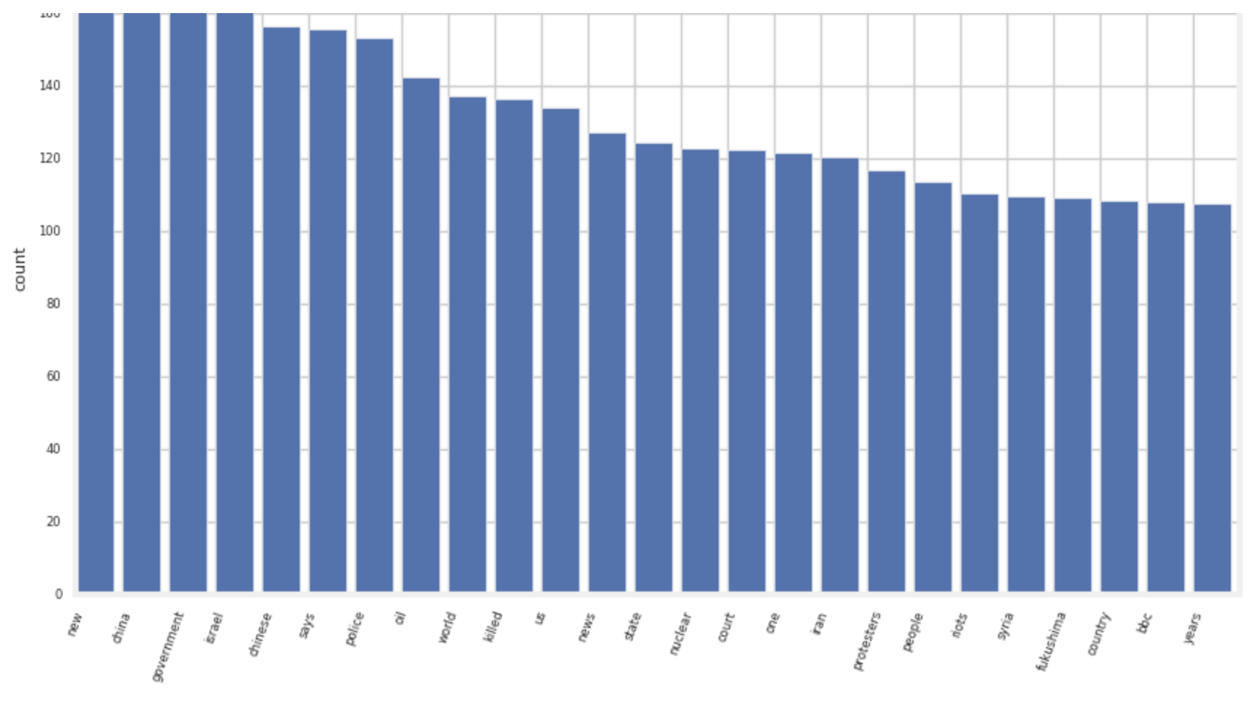
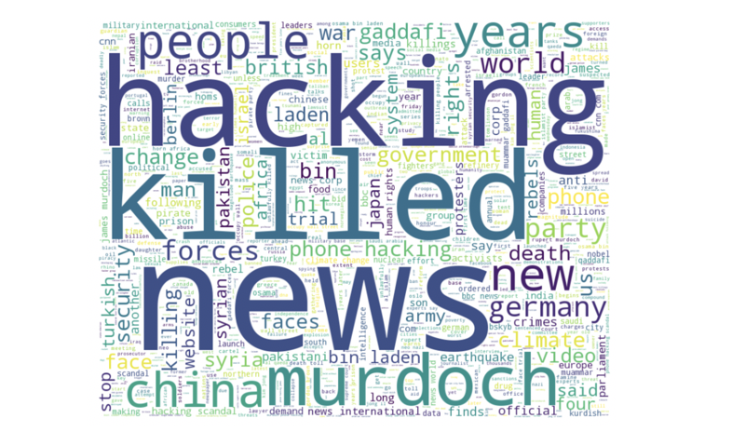
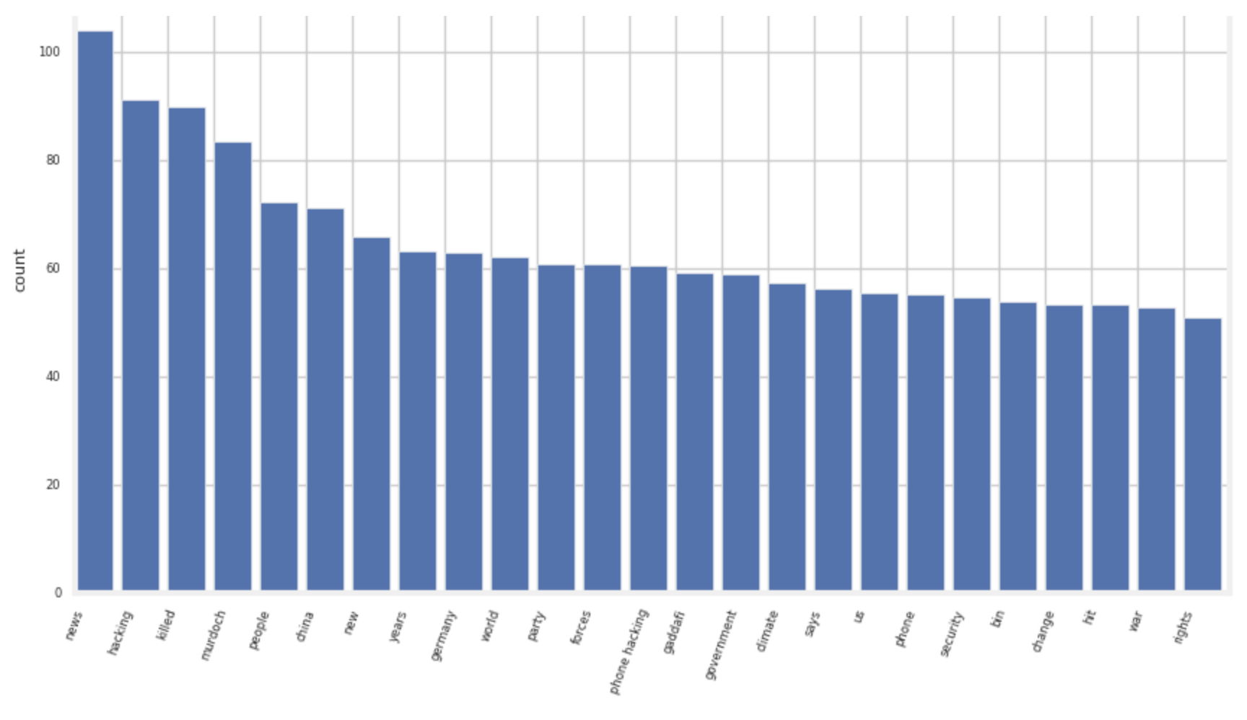
High and Low Words
Words related to a High
Words related to a Low
Notes:
Give a brief overview of the presentation. Describe the major focus of the presentation and why it is important.
Introduce each of the major topics.
To provide a road map for the audience, you can repeat this Overview slide throughout the presentation, highlighting the particular topic you will discuss next.

Slide 9
Classification Vivek Narayan algorithm
By using this extension of the Naive Bayes Model we hope to see an improvement in accuracy
The Vivekn algorithm for classification is used by John Snow Labs for text classification
Instead of just analyzing the one column we assemble a sentence and document output and include these in our analysis
Accuracy is highly impacted by use of negation handling; for example, “not good” if tokenized would count for positive sentiment(“good”), Vivekn algorithm handles this by classifying it as negative taking into consideration the negation
Notes:
Give a brief overview of the presentation. Describe the major focus of the presentation and why it is important.
Introduce each of the major topics.
To provide a road map for the audience, you can repeat this Overview slide throughout the presentation, highlighting the particular topic you will discuss next.

Slide 10
Method
The Sentence column is Tokenized
Normalizer is used to clean out the Tokens
Tokens then spell checked with English dictionary words
The Vivekn Sentiment Approach is set up
Pipeline is formed, train data fitted, and transformed test data
Notes:
Give a brief overview of the presentation. Describe the major focus of the presentation and why it is important.
Introduce each of the major topics.
To provide a road map for the audience, you can repeat this Overview slide throughout the presentation, highlighting the particular topic you will discuss next.

Slide 11
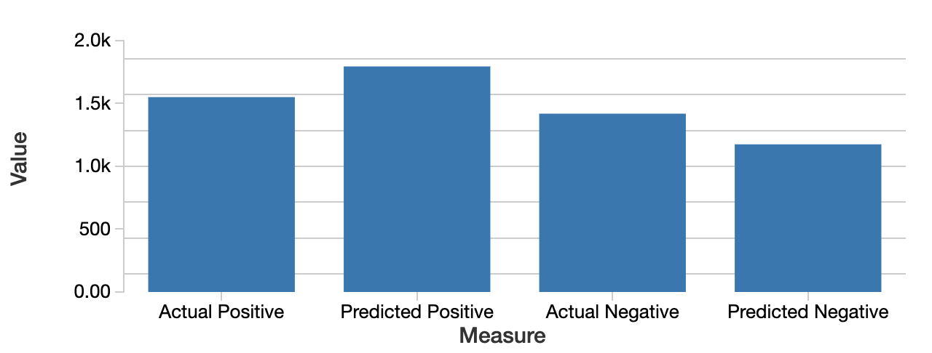
Results of Vivekn Algorithm
1551 1795 1419 1175
Area under PR = 0.67
Area under ROC = 0.65
Notes:
Give a brief overview of the presentation. Describe the major focus of the presentation and why it is important.
Introduce each of the major topics.
To provide a road map for the audience, you can repeat this Overview slide throughout the presentation, highlighting the particular topic you will discuss next.

Slide 12
Logistic Regression vs Vivekn Classification
Area under PR = 0.53
Area under ROC = 0.51
Area under PR = 0.67
Area under ROC = 0.65
Comparing the two models Logistic Regression and Vivekn Classification we see that the simple enhanced version of Naïve Bayes(Vivekn) gives us a better accuracy and even a better execution time
Notes:
Give a brief overview of the presentation. Describe the major focus of the presentation and why it is important.
Introduce each of the major topics.
To provide a road map for the audience, you can repeat this Overview slide throughout the presentation, highlighting the particular topic you will discuss next.

Slide 13
Conclusion
The models struggle to accurately predict the change in Dow Jones
We have a few ideas for why this model struggles:
The market is arguably to be a random walk. Although there is some direction to its movements, there is still quite a bit of randomness to its movements.
The news that we used might not be the most relevant. Perhaps the model would give better results if we took relevant news into consideration
Many people have worked on this task for years and companies spend millions of dollars to try to predict the movements of the market, so we don't expect anything too great considering the small amount of data that we are working with and the simplicity of our model.
The market depends on a variety of other factors as well which we did not take into consideration
Notes:
Give a brief overview of the presentation. Describe the major focus of the presentation and why it is important.
Introduce each of the major topics.
To provide a road map for the audience, you can repeat this Overview slide throughout the presentation, highlighting the particular topic you will discuss next.

Slide 14


THANK YOU
z
Notes:
POSISTION BASED
The virtual world is in a physical space. Position- based AR ties augmented reality content to a specific location.
MARKER BASED
We call the distinctive picture that can be recognised by the device, the marker.

Slide 15
References
https://www.kaggle.com/aaron7sun/stocknews
https://arxiv.org/ftp/arxiv/papers/1305/1305.6143.pdf
https://github.com/JohnSnowLabs/spark-nlp-workshop/blob/master/jupyter/training/english/vivekn-sentiment/VivekNarayanSentimentApproach.ipynb
Notes:
Give a brief overview of the presentation. Describe the major focus of the presentation and why it is important.
Introduce each of the major topics.
To provide a road map for the audience, you can repeat this Overview slide throughout the presentation, highlighting the particular topic you will discuss next.

